Slide 1
MY ROVEROID
Guide: Dr . John Pradeep D.
SC: Manjari Bisht-17BCE7075
Members: Rohit Bhargav Peesa-17BEC7024
Manoj Kumar Pydimarri-17BEV7012
Rutvi Boda-17BCD7018
Sai Pranay Reddy- 17BCD7021

Slide 2
Completed prototype
It moves based on our inputs using hand gestures
Robotic arm moves with potentiometer
We have live transmission
Object colour detection

Slide 3
Work done by each team member according to present prototype:
Manjari-coding for gyro sensor and rover.
Manoj-rover connections and gyro sensor connections, rover code errors setting.
Rutvi –Design and making of robotic arm
Pranay-worked with Bluetooth communication between pi and Arduino but due to various reasons we have removed serial communication, worked with manoj in rover
Rohit-Worked with live transmission, connections of robotic arm, coding of robotic arm, worked with image recognition but couldn’t get required results with image recognition.

Slide 4
It is a car which moves with hand gestures using gyro sensor and mobile application.
It has a robotic arm to pick objects which is controlled by using a potentiometer.
It has the ability of live transmission using 8MP raspberry camera module connected on the PI.
We can view live in any of cellular devices connected to hotspot by entering IP address in mobile phone . https<IP>:8080.html
So, we have partially completed our objectives planned initially.
Objectives which meet outcome

Slide 5
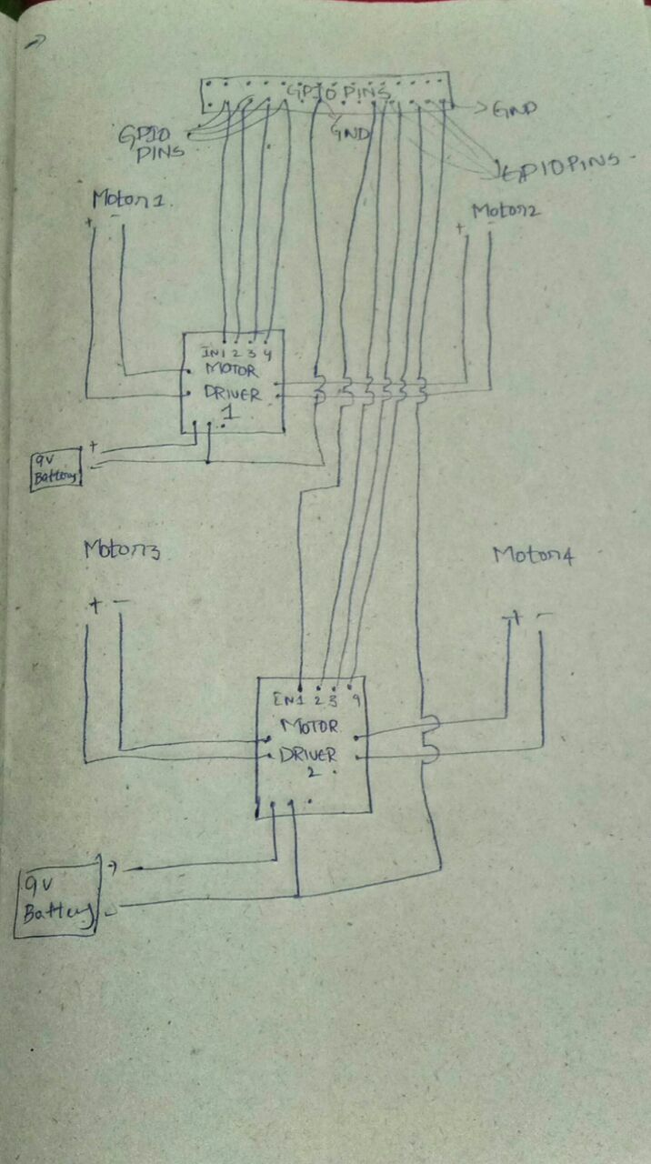
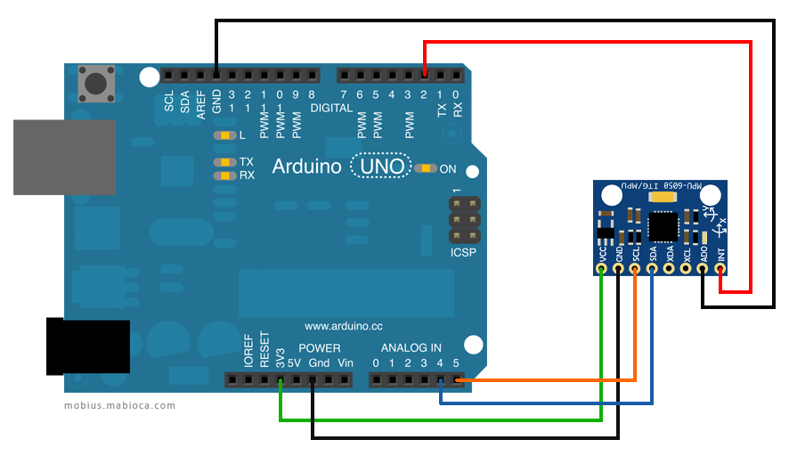
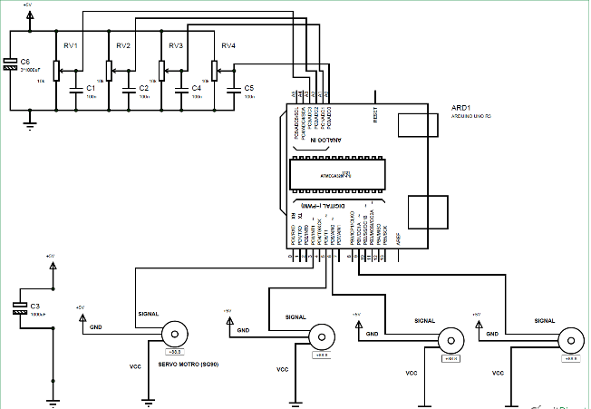
Circuit diagrams

Slide 6
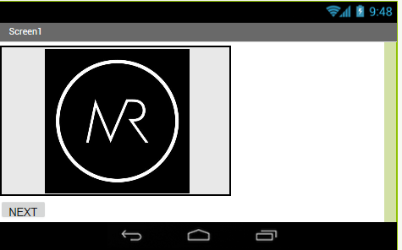
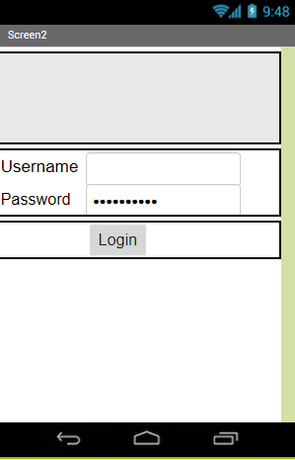
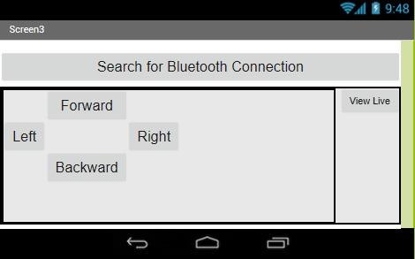
Results

Slide 7
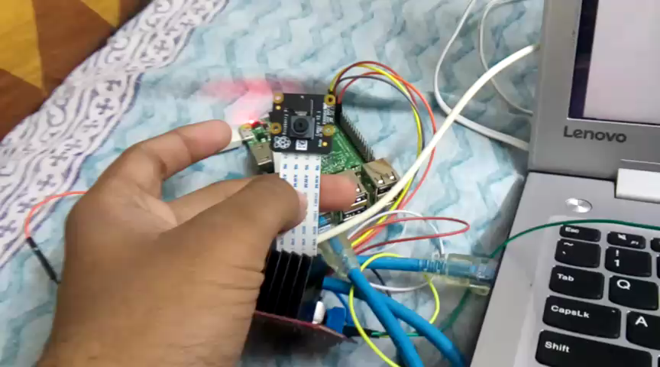

Slide 8
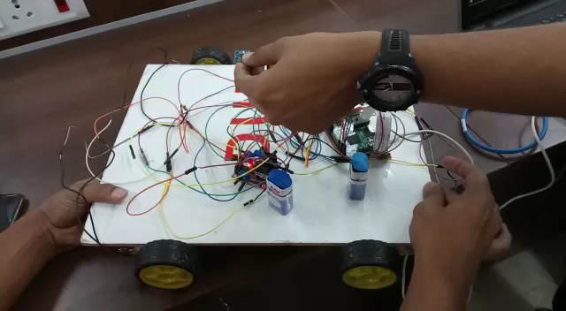

Slide 9
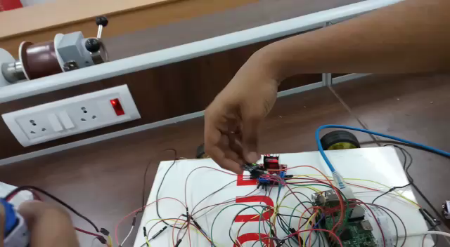

Slide 10
Problems:
If we have live then object detection is difficult as both cannot happen simultaneously.

Slide 11
Future Improvements
We can add GPS module to find location, using GPS we can set a location and send rover to specific location.
We can add temperature, humidity and pressure then make it like small mobile weather station.
We can not only recognise present requirement but we can add various requirements like face recognition, using touch sensor we can make it encrypted.
We can control whole project using Alexa as voice based system.

Slide 12
References:
www.tensorflow.org
www.hackster.io
www.opencv.org
www.github.com
www.circuitdigest.com

